Slide 1

Web 3 Wallet Trust Analytics
Judy Liang

Slide 2
Project Overview:
Goal:
Analyze Ethereum wallet behavior
Identify human vs bot-like activity
Build a trust scoring system
Approach:
Data pipeline + feature engineering
Behavioral modeling
API + dashboard

Slide 3
Data Pipeline
Data Source:
Etherscan API
Process:
Retrieve wallet transaction data
Clean and preprocess raw data
Structure dataset for analysis

Slide 4
Feature Engineering
Key Features:
Transaction frequency
Wallet Age
Activity consistency
Counterparty diversity
Purpose:
Capture behavioral patterns
Distinguish human vs automated activity

Slide 5
Trust Scoring Model
Model Type:
Rule-based scoring system
Outputs:
Trust score
Trust tier (Bronze / Silver / Gold)
Human Likelihood (Low / Medium / High)
Idea:
Combine multiple behavioral signals

Slide 6
Risk Scoring Framework
Definition:
High-risk wallets exhibit abnormal or bot-like transaction behavior.
Key Signals:
High transaction frequency
Low wallet age
Irregular or burst activity patterns
Interpretation:
These signals indicate automated or suspicious behavior
Wallets with low trust scores are treated as higher risk
Application:
Flag potentially risky wallets
Support risk control and monitoring in Web3 systems

Slide 7
Risk Interpretation Example
Example 1 (High Risk):
Very high transaction frequency
Low wallet age
Likely automated → High risk
Example 2 (Low Risk):
Stable transaction pattern
Moderate activity
Likely human → Low risk

Slide 8
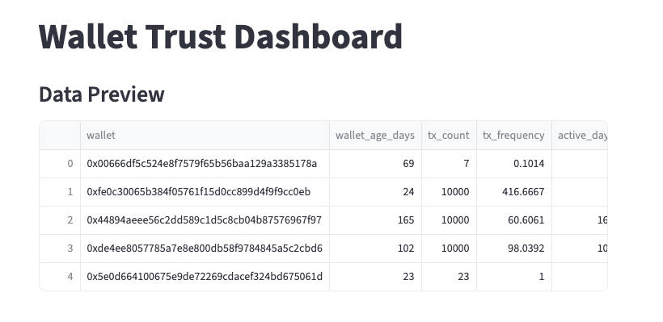
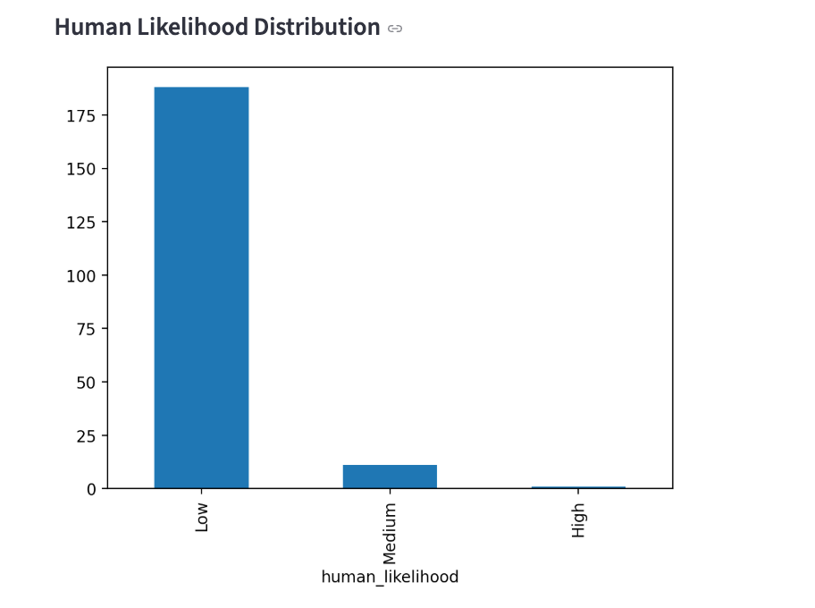
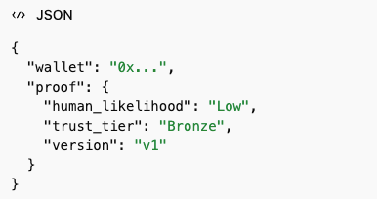
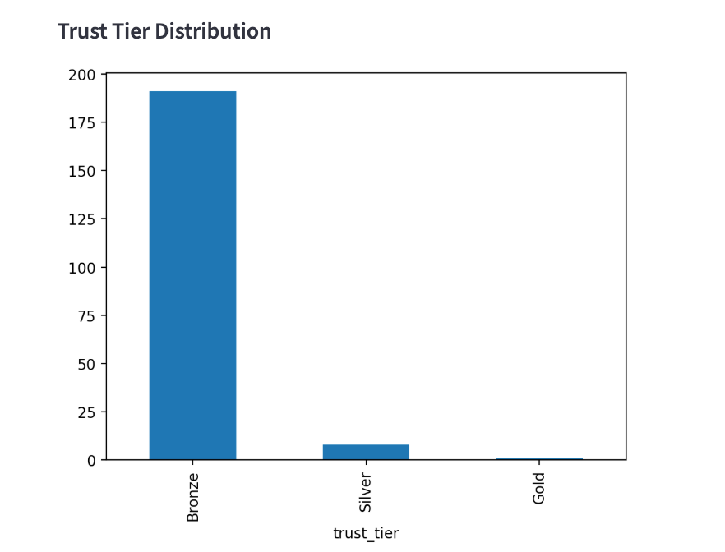
Week 4: API & Dashboard
Query wallet → return trust evaluation
Proof-style JSON output
Dashboard:
Visualize trust tier distribution
Analyze wallet behavior patterns
System:
End-to-end analytics pipeline

Slide 9
Key Insights
Findings:
High burst activity → likely bot-like behavior
Stable activity → higher trust
Behavioral signals useful for risk detection
Most wallets fall into low trust categories, suggesting a high proportion of bot-like behavior.

Slide 10
Conclusion
Summary:
Built end-to-end wallet analytics system
Data → Features → Model → API → Dashboard
This system can support risk detection and user classification in Web3 environments.
Applications:
Risk control
Fraud detection
User classification

Slide 11
THANK YOU

